Slide 1
Awareness for Cyber Security

Slide 2

?

Slide 3
What is Cyber Security?
Cybersecurity is the practice of protecting systems, networks, programs, and data from cyber attacks.
It's about reducing the risk of unauthorized access to devices, services, and personal information.

Slide 4
How can we protect?
Read Privacy policy carefully when you submit the data through internet.
Read carefully permissions.
Don’t Allows permissions without reading information.
Don’t share your passwords to anyone.
Keep your information private.

Slide 5
Safety tips…
Use antivirus software in your pc/laptop.
Insert Firewall, pop up blocker
Maintain Backup
Check security setting
Use secure connection
------------------------------------Main-----------------------------------
Use strong passwords , don’t give personal information unless required.

Slide 6
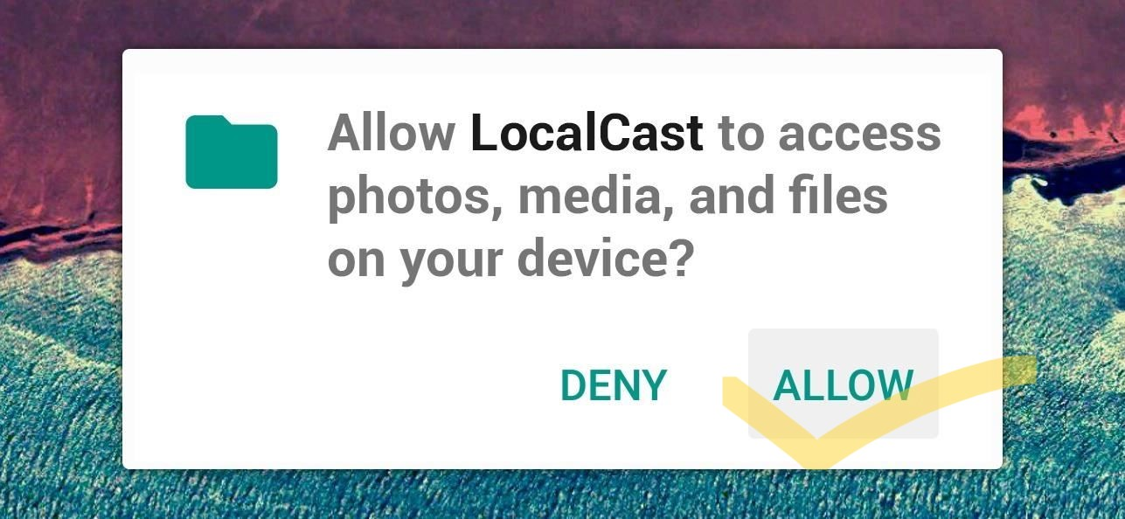
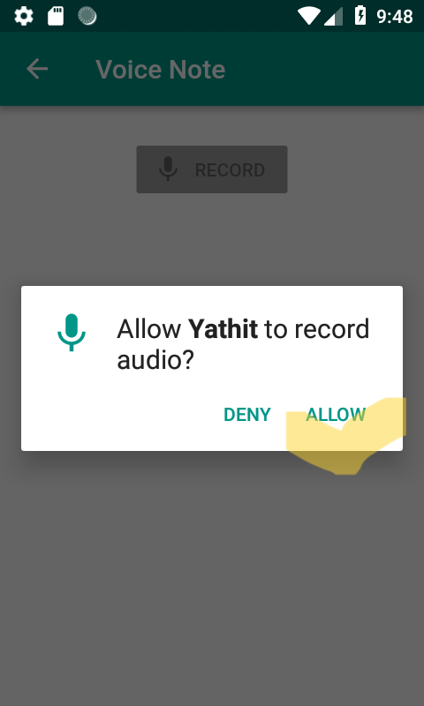
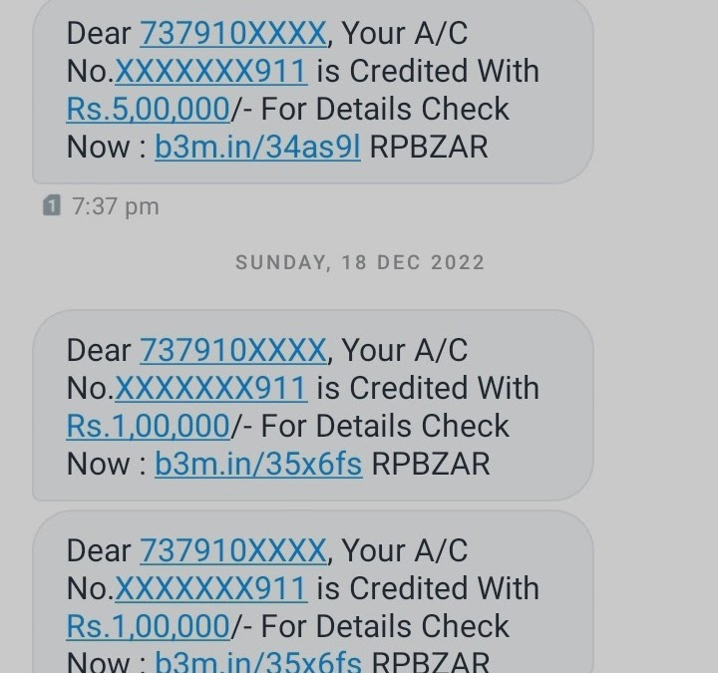

What do we do….

Slide 7
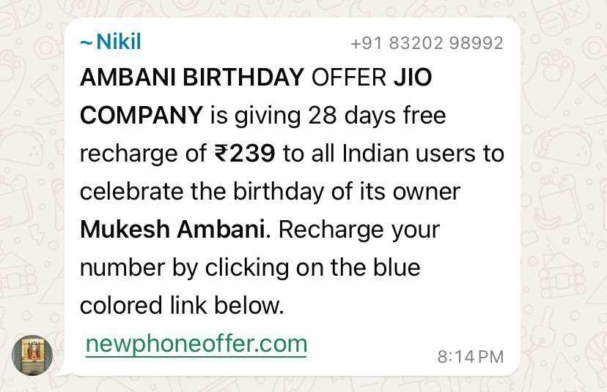

Slide 8


Khatam tata bye byee…(Gaya)

Slide 9
BE aware….
Don’t tap any unknown link.
Its may be share your all data who access your computer.
Slides by Varun Asodariya
7623834331

